Slide 1

Orthopaedic Injuries
CHAPTER 32

Slide 2
National EMS Education Standard Competencies (1 of 5)
Trauma
Applies fundamental knowledge to provide basic emergency care and transportation based on assessment findings for an acutely injured patient.
Notes:
National EMS Education Standard Competencies
Trauma
Applies fundamental knowledge to provide basic emergency care and transportation based on assessment findings for an acutely injured patient.

Slide 3
National EMS Education Standard Competencies (2 of 5)
Orthopaedic Trauma
Recognition and management of
  Open fractures
  Closed fractures
  Dislocations
  Amputations
Notes:
National EMS Education Standard Competencies
Orthopaedic Trauma
• Recognition and management of
• Open fractures
• Closed fractures
• Dislocations
• Amputations

Slide 4
National EMS Education Standard Competencies (3 of 5)
Pathophysiology, assessment, and management of
  Upper and lower extremity orthopaedic trauma
  Open fractures
  Closed fractures
  Dislocations
  Sprains/strains
  Pelvic fractures
  Amputations/replantation
Notes:
National EMS Education Standard Competencies
Pathophysiology, assessment, and management of
• Upper and lower extremity orthopaedic trauma
• Open fractures
• Closed fractures
• Dislocations
• Sprains/strains
• Pelvic fractures
• Amputations/replantation

Slide 5
National EMS Education Standard Competencies (4 of 5)
Medicine
Applies fundamental knowledge to provide basic emergency care and transportation based on assessment findings for an acutely ill patient.
Notes:
National EMS Education Standard Competencies
Medicine
Applies fundamental knowledge to provide basic emergency care and transportation based on assessment findings for an acutely ill patient.

Slide 6
National EMS Education Standard Competencies (5 of 5)
Nontraumatic Musculoskeletal Disorders
Anatomy, physiology, pathophysiology, assessment, and management of
  Nontraumatic fractures
Notes:
National EMS Education Standard Competencies
Nontraumatic Musculoskeletal Disorders
Anatomy, physiology, pathophysiology, assessment, and management of
• Nontraumatic fractures

Slide 7
Introduction (1 of 2)
The musculoskeletal system provides:
  Form
  Upright posture
  Movement
System also protects vital internal organs.
  Bones, muscles, tendons, cartilage, and ligaments are still at risk.
Notes:
Lecture Outline
I. Introduction
A. The human body is a well-designed system in which form, upright posture, and movement are provided by the musculoskeletal system.
B. The system also protects the vital internal organs of the body.

Slide 8
Introduction (2 of 2)
Musculoskeletal injuries are among the most common reasons why patients seek medical attention.
  Often easily identified because of associated pain, swelling, and deformity
  Often result in short- or long-term disability
Notes:
Lecture Outline
C. Musculoskeletal injuries are among the most common reasons why patients seek medical attention.
1. Musculoskeletal injuries are often easily identified because of pain, swelling, and deformity.
2. Although musculoskeletal system injuries are rarely fatal, they often result in short- or long-term disability.
D. Do not focus solely on a musculoskeletal injury without first determining that no life-threatening injuries exist.

Slide 9
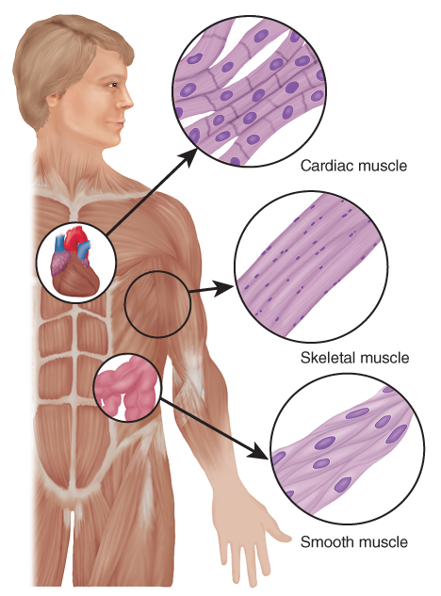
Anatomy and Physiology of the
Musculoskeletal System (1 of 5)
Three types of muscles: skeletal, smooth, and cardiac
FIGURE 32-1 For musculoskeletal injuries, the major muscle type involved is skeletal muscle.
© Jones & Bartlett Learning.
Notes:
Lecture Outline
II. Anatomy and Physiology of the Musculoskeletal System
A. Muscles

Slide 10
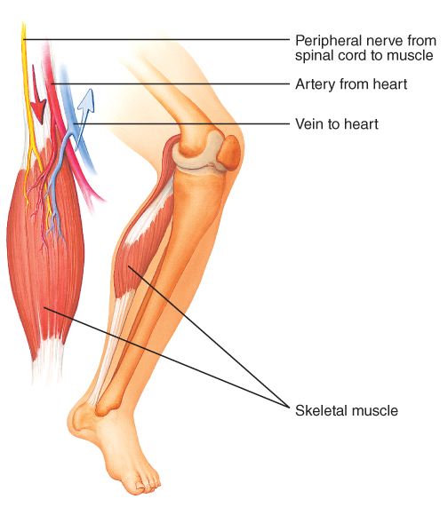
Anatomy and Physiology of the
Musculoskeletal System (2 of 5)
Skeletal muscle attaches to the bones and usually crosses at least one joint.
  Also called voluntary muscle
  Makes up the largest portion of the body’s muscle mass
FIGURE 32-2 Skeletal muscles are supplied by arteries,
veins, and nerves that bring oxygen and nutrients, carry away waste products, and conduct nervous stimuli.
© Jones & Bartlett Learning.
Notes:
Lecture Outline
Skeletal muscle
a. Also called striated muscle because of its characteristic stripes, attaches to the bones and usually crosses at least one joint.
b. Called voluntary muscle because it is under direct voluntary control of the brain, responding to commands to move specific body parts
c. Makes up the largest portion of the body’s muscle mass.

Slide 11
Anatomy and Physiology of the
Musculoskeletal System (3 of 5)
All skeletal muscles are supplied with arteries, veins, and nerves.
Skeletal muscle tissue is directly attached to the bone by tendons.
Notes:
Lecture Outline
d. All skeletal muscles are supplied with arteries, veins, and nerves.
e. Skeletal muscle tissue is directly attached to the bone by tendons.

Slide 12
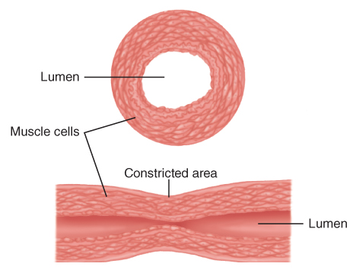
Anatomy and Physiology of the
Musculoskeletal System (4 of 5)
Smooth muscle performs much of the automatic work of the body.
  Contracts and relaxes to control the movement of the contents within tubular structures
FIGURE 32-3 Smooth muscle is found in the walls of most tubular structures in the body. These muscles contract and relax to control the movement of the contents within these structures.
© Jones & Bartlett Learning.
Notes:
Lecture Outline
2. Smooth muscle (involuntary muscle) performs much of the automatic work of the body.
a. Found in the walls of most tubular structures of the body.
b. Contracts and relaxes to control the movement of the contents within these structures

Slide 13
Anatomy and Physiology of the
Musculoskeletal System (5 of 5)
Cardiac muscle is a specially adapted involuntary muscle with its own regulatory system.
Notes:
Lecture Outline
3. Cardiac muscle is a specially adapted involuntary muscle with its own regulatory system.

Slide 14
The Skeleton (1 of 10)
Gives us our recognizable human form
Protects our vital organs
Allows us to move
Made up of approximately 206 bones
Produces blood cells (in the bone marrow)
Serves as a reservoir for minerals and electrolytes
Notes:
Lecture Outline
B. The skeleton
1. The skeleton gives us our recognizable human form, protects our vital internal organs, and allows us to move.
a. Made up of approximately 206 bones
b. The bones also produce blood cells (in the bone marrow) and serve as a reservoir for important minerals and electrolytes.

Slide 15
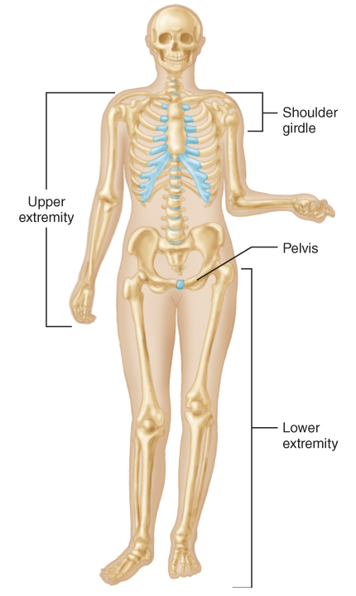
The Skeleton (2 of 10)
FIGURE 32-4 The human skeleton, consisting of
approximately 206 bones, gives us our form and protects our vital organs.
© Jones & Bartlett Learning.
Notes:
The figure on this slide illustrates the human skeleton.

Slide 16
The Skeleton (3 of 10)
The skull protects the brain.
The thoracic cage protects the heart, lungs, and great vessels.
The pectoral girdle consists of two scapulae and two clavicles.
Notes:
Lecture Outline
2. The skull is a solid vault like structure that surrounds and protects the brain.
3. The thoracic cage protects the heart, lungs, and great vessels
a. The lower ribs protect the liver and spleen.
4. The bony spinal canal encases and protects the spinal cord.
5. The pectoral (shoulder) girdle consists of two scapulae and two clavicles.
a. The scapula (shoulder blade) is a flat, triangular bone held to the rib cage by powerful muscles that buffer it against injury.
b. The clavicle (collarbone) is a slender, S-shaped bone attached by ligaments to the sternum on one end and to the acromion process on the other.
c. Because the clavicle is slender and very exposed, this bone is vulnerable to injury.

Slide 17
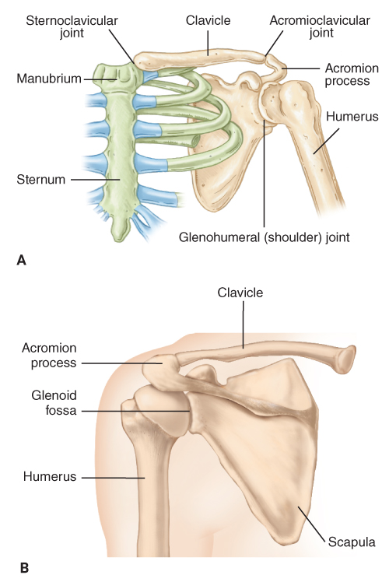
The Skeleton (4 of 10)
FIGURE 32-5 The pectoral girdle. A. Anterior view, including the clavicle. B. Posterior view, including the scapula.
A, B: © Jones & Bartlett Learning.
Notes:
The figure on this slide shows the pectoral girdle in the anterior view (A) and posterior view (B).

Slide 18
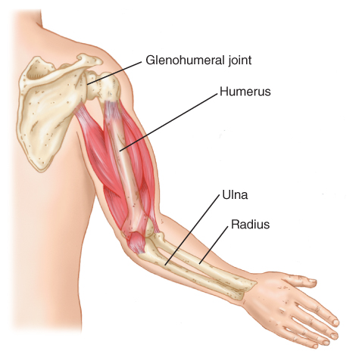
The Skeleton (5 of 10)
The upper extremity extends from the shoulder to the fingertips.
  Composed of the upper arm (humerus), elbow, and forearm (radius and ulna)
FIGURE 32-6 The anatomy of the arm.
© Jones & Bartlett Learning.
Notes:
Lecture Outline
6. The upper extremity extends from the shoulder to the fingertips and is composed of the upper arm (humerus), elbow, and forearm (radius and ulna).
a. Joins the shoulder girdle at the glenohumeral joint.
b. The humerus connects with the bones of the forearm to form the hinged elbow joint.

Slide 19
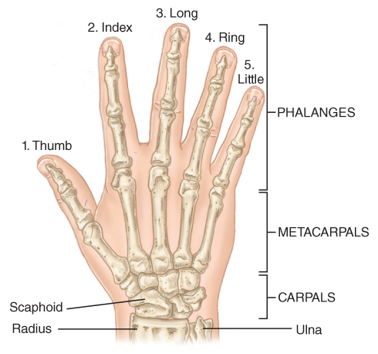
The Skeleton (6 of 10)
The hand contains three sets of bones:
  Wrist bones (carpals)
  Hand bones (metacarpals)
  Finger bones (phalanges)
FIGURE 32-7 The anatomy of the wrist and hand.
© Jones & Bartlett Learning.
Notes:
Lecture Outline
c. The hand contains three sets of bones.
i. Wrist bones (carpals)
ii. Hand bones (metacarpals)
iii. Finger bones (phalanges)

Slide 20
The Skeleton (7 of 10)
The pelvis supports the body weight and protects the structures within the pelvis: the bladder, rectum, and female reproductive organs.
Pelvic girdle is formed by the ischium, ilium, and pubis.
  Bones are fused to form the innominate (hip) bone.
Notes:
Lecture Outline
The pelvis supports the body weight and protects the structures within the pelvis: the bladder, rectum, and female reproductive organs.
a. The pelvic girdle is three separate bones: the ischium, ilium, and pubis.
b. Fused together to form the innominate (hip) bone

Slide 21
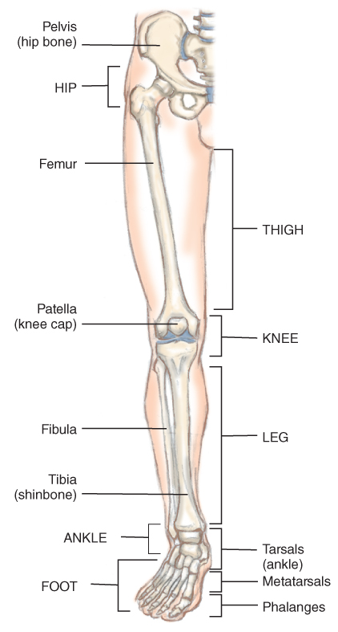
The Skeleton (8 of 10)
The lower extremity consists of the bones of the thigh, leg, and foot.
  Femur (thigh bone)
  Femoral head
  Tibia and fibula
  Patella (kneecap)
FIGURE 32-8 The bones of the thigh, leg, and foot.
© Jones & Bartlett Learning.
Notes:
Lecture Outline
8. The lower extremity consists of the bones of the thigh, leg, and foot.
a. The femur (thigh bone) is a long, powerful bone that connects in the ball-and-socket joint of the pelvis and in the hinge joint of the knee.
b. The lower leg consists of two bones, the tibia and the fibula.

Slide 22
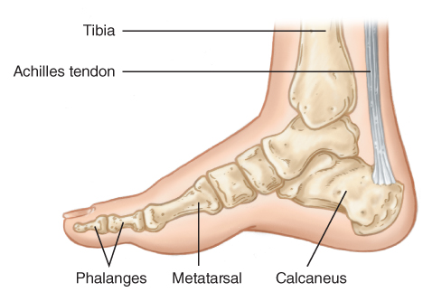
The Skeleton (9 of 10)
The foot consists of three classes of bones:
  Ankle bones (tarsals)
  Foot bones (metatarsals)
  Toe bones (phalanges)
FIGURE 32-9 The bones of the foot and ankle.
© Jones & Bartlett Learning.
Notes:
Lecture Outline
c. The foot consists of three classes of bones: ankle bones (tarsals), foot bones (metatarsals), and toe bones (phalanges).

Slide 23
The Skeleton (10 of 10)
The bones of the skeleton provide a framework to which the muscles and tendons are attached.
A joint is formed wherever two bones come into contact.
  Held together in a tough fibrous capsule
  Lubricated by synovial fluid
  Allows motion
Notes:
Lecture Outline
9. The bones of the skeleton provide a framework to which the muscles and tendons are attached.
10. A joint is formed wherever two bones come into contact.
a. Joints are held together in a tough fibrous structure known as a capsule, which is supported and strengthened in certain key areas by bands of fibrous tissue called ligaments.
b. In moving joints, the ends of bones are covered with a thin layer of cartilage known as articular cartilage.
c. Joints are bathed and lubricated by synovial (joint) fluid.
d. Joints allow circular motion (shoulder), hinge motion (knee and elbow), minimum motion (sacroiliac and sternoclavicular joints), or no motion (sutures in the skull).

Slide 24
Mechanism of Injury
Significant force is generally required to cause fractures and dislocations.
  Direct blows
  Indirect forces
  Twisting forces
  High-energy forces
Notes:
Lecture Outline
III. Musculoskeletal Injuries
A. Mechanism of injury (MOI)
1. Significant force is generally required to cause fractures and dislocations.
a. Direct blows
b. Indirect forces
c. Twisting forces
d. High-energy forces
2. A significant MOI is not always necessary to fracture a bone.
a. A slight force can easily fracture a bone that is weakened by a tumor, infection, or osteoporosis.
b. Suspect the presence of a fracture in any older patient who reports pain or has sustained a mild injury.

Slide 25
Fractures (1 of 8)
A break in the continuity of the bone
Classified as either closed or open
Determine whether the overlying skin is damaged.
  Treat any injury that breaks the skin as a possible open fracture.
Notes:
Lecture Outline
B. Fractures
1. A break in the continuity of the bone, often occurring as a result of an external force.
2. Classified as either closed or open.
a. With an open fracture, there is an external wound, caused either by the same blow that fractured the bone or by the broken bone ends lacerating the skin.
b. You should treat any injury that breaks the skin as a possible open fracture.
c. Complications of open fractures include increased blood loss and a higher likelihood of infections.

Slide 26
Fractures (2 of 8)
Fractures are described by whether the bone is moved from its normal position.
  A nondisplaced fracture is a simple crack of the bone.
  A displaced fracture produces actual deformity or distortion of the limb.
Notes:
Lecture Outline
3. Fractures are also described by whether the bone is moved from its normal position.
a. A nondisplaced fracture (also known as a hairline fracture) is a simple crack of the bone that may be difficult to distinguish from a sprain or simple contusion.
b. A displaced fracture produces an actual deformity, or distortion, of the limb by shortening, rotating, or angulating it.

Slide 27
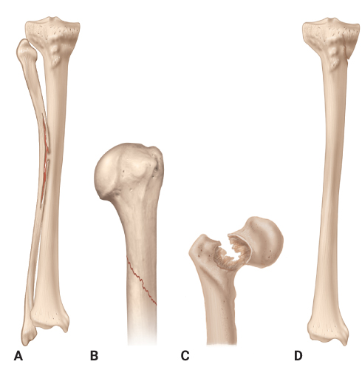
Fractures (3 of 8)
FIGURE 32-15 Special terms to describe fractures.
A. Greenstick fracture. B. Oblique fracture.
C. Pathologic fracture. D. Incomplete fracture.
A-D: © Jones & Bartlett Learning.
Notes:
Lecture Outline
4. Special terms to describe particular types of fractures

Slide 28
Fractures (4 of 8)
Comminuted
  A fracture in which the bone is broken into more than two fragments
Epiphyseal
  A fracture in the growth section of a child’s bone
Greenstick
  An incomplete fracture that passes only partway through the shaft of a bone
Notes:
Lecture Outline
a. Comminuted: A fracture in which the bone is broken into more than two fragments
b. Epiphyseal: A fracture that occurs in a growth section of a child’s bone and may lead to growth abnormalities.
c. Greenstick: An incomplete fracture that passes only partway through the shaft of a bone

Slide 29
Fractures (5 of 8)
Incomplete
  A fracture that does not run completely through the bone
Oblique
  A fracture in which the bone is broken at an angle across the bone
Pathologic
  A fracture of weakened or diseased bone
Notes:
Lecture Outline
d. Incomplete: A fracture that does not run completely through the bone
e. Oblique: A fracture in which the bone is broken at an angle across the bone
f. Pathologic: A fracture of weakened or diseased bone generally produced by minimal force

Slide 30
Fractures (6 of 8)
Spiral
  A fracture caused by a twisting force, causing an oblique fracture around and through the bone
Transverse
  A fracture that occurs straight across the bone
Notes:
Lecture Outline
g. Spiral: A fracture caused by a twisting force, causing an oblique fracture around the bone and through the bone
h. Transverse: A fracture that occurs straight across the bone

Slide 31
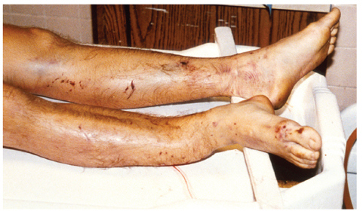
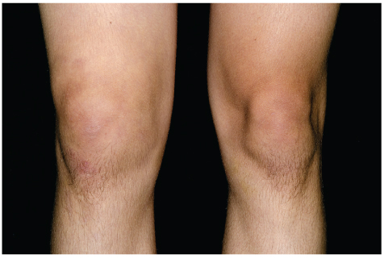
Fractures (7 of 8)
Suspect a fracture if one or more of the following signs are present:
  Deformity
  Tenderness
  Guarding
  Swelling
FIGURE 32-16 Obvious deformity, shortening, rotation, or angulation should increase your index of suspicion for a fracture.
© Charles Stewart MD, EMDM MPH.
FIGURE 32-18 Swelling that occurs in association with a fracture can often mask deformity of the limb.
Figure 32-18
© Dr. P. Marazzi/Science Source.
Notes:
Lecture Outline
5. Suspect a fracture if one or more of the following signs are present:
a. Deformity
b. Tenderness
c. Guarding
d. Swelling

Slide 32
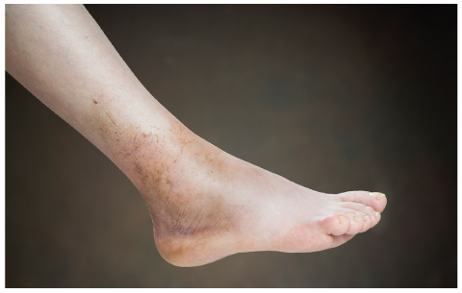
Fractures (8 of 8)
Signs of fractures (cont’d)
  Bruising
  Crepitus
  False motion
  Exposed fragments
  Pain
  Locked joint
FIGURE 32-19 Fractures almost always have associated
bruising into the surrounding soft tissue.
© fotokostic/iStockphoto.
Notes:
Lecture Outline
e. Bruising
f. Crepitus
g. False motion
h. Exposed fragments
i. Pain
j. Locked joint

Slide 33
Dislocations (1 of 2)
A disruption of a joint in which the bone ends are no longer in contact
Sometimes a dislocated joint will spontaneously reduce.
  Confirm the dislocation with the patient history.
  A dislocation that does not reduce is a serious problem.
Notes:
Lecture Outline
D. Dislocations
1. A disruption of a joint in which the bone ends are no longer in contact
2. The supporting ligaments are often torn, usually completely, allowing the bone ends to separate completely from each other.
3. A fracture-dislocation is a combination injury at the joint in which the joint is dislocated and there is a fracture of the end of one or more of the bones.
4. Sometimes a dislocated joint will spontaneously reduce, or return to its normal position, before your assessment.
a. You will be able to confirm the dislocation only by taking a patient history.
b. A dislocation that does not spontaneously reduce is a serious problem.
c. Commonly dislocated joints include the fingers, shoulder, elbow, and knee.

Slide 34
Dislocations (2 of 2)
Signs and symptoms
  Marked deformity
  Swelling
  Pain that is aggravated by any attempt at movement
  Tenderness on palpation
  Loss of normal joint motion
  Numbness or impaired circulation
Notes:
Lecture Outline
5. The signs and symptoms of a dislocated joint are similar to those of a fracture.
a. Marked deformity
b. Swelling
c. Pain that is aggravated by any attempt at movement
d. Tenderness on palpation
e. Virtually complete loss of normal joint motion (locked joint)
f. Numbness or impaired circulation to the limb or digit

Slide 35
Sprains (1 of 2)
Occur when a joint is twisted or stretched beyond its normal range of motion.
  Can range from mild to severe
  Most vulnerable joints are the knees, shoulders, and ankles
  Severe deformity does not typically occur.
Notes:
Lecture Outline
E. Sprains
1. A sprain occurs when a joint is twisted or stretched beyond its normal range of motion.
2. The supporting capsule and ligaments are stretched or torn.
3. Sprains can range from mild to severe.
4. The most vulnerable joints are the knees, shoulders, and ankles.
5. After the injury, the alignment generally returns to a fairly normal position.

Slide 36
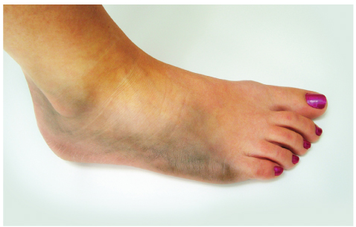
Sprains (2 of 2)
Signs and symptoms
  Guarding
  Swelling and ecchymosis
  Pain
  Instability of the joint
FIGURE 32-23 Sprains often occur in the knee or
ankle and are characterized by swelling, bruising, point tenderness, pain, and joint instability.
© Sean Gladwell/Dreamstime.com.
Notes:
Lecture Outline
Signs and symptoms of a sprain:
a. Guarding
b. Swelling and ecchymosis
c. Pain
d. Instability of the joint

Slide 37
Strain
A stretching or tearing of the muscle.
Causes pain, swelling, and bruising of the soft tissues in the area
  Often no deformity is present and only minor swelling is noted at the site of the injury.
Notes:
Lecture Outline
E. Strain
1. A strain (pulled muscle) is a stretching or tearing of the muscle, causing pain, swelling, and bruising of the soft tissues in the area.
2. Unlike a sprain, no ligament or joint damage typically occurs.
3. Often no deformity is present and only minor swelling is noted at the site of the injury.
4. Most patients will have extreme point tenderness.

Slide 38
Amputations
An amputation is an injury in which an extremity is completely severed from the body.
Can damage every aspect of the musculoskeletal system
Notes:
Lecture Outline
F. Amputations
1. An amputation is an injury in which an extremity is completely severed from the body.
2. This injury can damage every aspect of the musculoskeletal system—from bone to ligament to muscle.

Slide 39
Complications (1 of 3)
Orthopaedic injuries can also lead to systemic changes or illnesses.
Likelihood of having a complication is related to the:
  Strength of the force that caused the injury
  Injury’s location
  Patient’s overall health
Notes:
Lecture Outline
G. Complications
1. Orthopaedic injuries can lead to numerous complications—not just those involving the skeletal system, but also systemic changes or illnesses.
2. The likelihood of having a complication is often related to the:
a. Strength of the force that caused the injury
b. Injury’s location
c. Patient’s overall health

Slide 40
Complications (2 of 3)
To prevent contamination following an open fracture:
  Brush away any debris on the skin.
  Do not enter or probe the fracture site.
Long-term disability is one of the most devastating consequences of an orthopaedic injury.
Notes:
Lecture Outline
3. To prevent contamination following an open fracture, you should brush away any obvious debris on the skin surrounding an open fracture before applying a dressing.
a. Do not enter or probe the open fracture site.
4. You can help reduce the risk or duration of long-term disability by:
a. Preventing further injury
b. Reducing the risk of wound infection
c. Transporting patients to an appropriate medical facility

Slide 41
Complications (3 of 3)
You can help reduce the risk or duration of long-term disability by:
  Preventing further injury
  Reducing the risk of wound infection
  Minimizing pain by the use of cold and analgesia
  Transporting patients to an appropriate medical facility
Notes:
Lecture Outline
4. You can help reduce the risk or duration of long-term disability by:
a. Preventing further injury
b. Reducing the risk of wound infection
c. Transporting patients to an appropriate medical facility

Slide 42
Assessing the Severity of Injury
The Golden Hour is critical for life and for preserving limb viability.
  Prolonged hypoperfusion can cause significant damage.
  Any suspected open fracture or vascular injury is a critical emergency.
Most injuries are not critical.
Notes:
Lecture Outline
H. Assessing the severity of injury
1. The Golden Period is critical not only for life, but also for preserving limb viability.
a. In an extremity with anything less than complete circulation, prolonged hypoperfusion can cause significant damage.
b. Any suspected open fracture or vascular injury is considered a critical emergency.
2. Remember that most injuries are not critical.

Slide 43
Patient Assessment
Always look at the big picture.
  Distinguish mild injuries from severe injuries.
  Severe injuries may compromise neurovascular function, which could be limb threatening.
Notes:
Lecture Outline
IV. Patient Assessment
A. Always look at the big picture, evaluating the overall complexity of the situation to determine and treat any life threats.
1. You must be able to distinguish mild injuries from severe injuries because some severe injuries may compromise neurovascular function, which could threaten long-term function.

Slide 44
Scene Size-up (1 of 2)
Scene safety
  Identify the forces associated with the MOI.
  Use standard precautions.
  Consider that there may be hidden bleeding.
  Evaluate the need for additional support.
Notes:
Lecture Outline
B. Scene size-up
1. Scene safety
a. Try to identify the forces associated with the MOI.
b. Standard precautions may be as simple as gloves, but a mask and gown may be necessary.
c. Consider the possibility that there may be hidden bleeding.
d. Evaluate the need for law enforcement support, advanced life support, or additional ambulances.

Slide 45
Scene Size-up (2 of 2)
Mechanism of injury/nature of illness
  Look for indicators of the MOI.
  Be alert for both primary and secondary injuries.
  Consider what injuries the MOI would lead you to expect.
Notes:
Lecture Outline
2. Mechanism of injury/nature of illness
a. Look for indicators of the MOI.
b. Be alert for both primary and secondary injuries.
c. Consider what injuries the MOI would lead you to expect.

Slide 46
Primary Assessment (1 of 5)
Focus on identifying and managing life threats.
Treat patient according to level of consciousness and XABCs.
  Address bleeding and treat for shock.
  Check for responsiveness using the AVPU scale.
  Ask about the chief complaint.
Notes:
Lecture Outline
C. Primary assessment
1. Focus on identifying and managing life threats.
2. Treating the patient according to his or her level of consciousness and XABCs is always the priority.
a. Check for responsiveness using the AVPU scale.

Slide 47
Primary Assessment (2 of 5)
Treat patient (cont’d)
  Administer high-flow oxygen to all patients whose level of consciousness is less than alert and oriented.
  Ask about the MOI.
  If there was significant trauma, the musculoskeletal injuries may be a lower priority.
Notes:
Lecture Outline
b. Administer high-flow oxygen via a nonrebreathing mask or a BVM to all patients whose level of consciousness is less than alert and oriented.
c. Ask about the MOI.
d. If there was significant trauma and multiple body systems are affected, the musculoskeletal injuries may be a lower priority.

Slide 48
Primary Assessment (3 of 5)
Airway and breathing
  Fractures and sprains usually do not create airway and breathing problems.
  Evaluate the chief complaint and MOI.
Notes:
Lecture Outline
3. Fractures and sprains usually do not create airway and breathing problems.

Slide 49
Primary Assessment (4 of 5)
Circulation
  Determine whether the patient has a pulse, has adequate perfusion, or is bleeding.
  If the skin is pale, cool, or clammy and capillary refill time is slow, treat for shock.
  Maintain a normal body temperature.
Notes:
Lecture Outline
4. Focus on determining whether the patient has a pulse, has adequate perfusion, or is bleeding.
a. If the skin is pale, cool, or clammy and capillary refill time is slow, treat your patient for shock immediately.
b. Maintain a normal body temperature.
c. Stabilize injuries in the extremities prior to moving the patient.

Slide 50
Primary Assessment (5 of 5)
Transport decision
  Provide rapid transport if the patient has an airway or breathing problem or significant bleeding.
  A patient who has a significant MOI but whose condition appears stable should also be transported promptly.
  Patients with a simple MOI may be further assessed on scene.
Notes:
Lecture Outline
5. Transport decision
a. If the patient you are treating has an airway or breathing problem, or significant bleeding, provide rapid transport to the hospital for treatment.
b. A patient who has a significant MOI but whose condition appears otherwise stable should also be transported promptly.
c. When a decision for rapid transport is made, you can use a backboard as a splinting device to splint the whole body rather than splinting each extremity individually.
d. Patients with a simple MOI may be further assessed and their condition stabilized on scene prior to transport if no other problems exist.

Slide 51
History Taking
Obtain a medical history and be alert for injury-specific signs and symptoms and any pertinent negatives.
Obtain a SAMPLE history for all trauma patients.
  OPQRST is too lengthy when ABCs require immediate attention.
Notes:
Lecture Outline
D. History taking
1. Obtain a medical history and be alert for injury-specific signs and symptoms and any pertinent negatives.
2. Obtain a SAMPLE history for all trauma patients.
a. How much and in what detail you explore this history depends on the seriousness of the patient’s condition and how quickly you need to transport him or her to the hospital.
b. OPQRST can be of limited use in cases of severe injury and is usually too lengthy when matters of airway, breathing, circulation, and rapid transport require immediate attention.

Slide 52
Secondary Assessment (1 of 2)
Physical examinations
  If significant trauma has occurred, start with a secondary assessment of the entire body.
  Begin with the head and work systematically toward the feet.
  Use DCAP-BTLS to assess the musculoskeletal system.
Notes:
Lecture Outline
E. Secondary assessment
1. Physical examinations
a. If significant trauma has likely affected multiple systems, start with a secondary assessment of the entire body to be sure that you have found all of the problems and injuries.
b. Begin with the head and work systematically toward the feet, checking the head, chest, abdomen, extremities, and back.
c. The goal is to identify hidden and potentially life-threatening injuries.
d. Use the DCAP-BTLS approach to assess the musculoskeletal system.

Slide 53
Secondary Assessment (2 of 2)
Physical examinations (cont’d)
  When lacerations are present in an extremity, consider an open fracture.
  Any injury or deformity of the bone may be associated with vessel or nerve injury.
  Assess neurovascular function.
  Use the 6 Ps of musculoskeletal assessment.
  Obtain a baseline set of vital signs
Notes:
Lecture Outline
e. When lacerations are present in an extremity, an open fracture must be considered, bleeding controlled, and dressings applied.
f. Any injury or deformity of the bone may be associated with vessel or nerve injury.
i. Obtain a baseline neurovascular assessment
ii. Always recheck the neurovascular function before and after you splint or otherwise manipulate the limb.
g. Examination of the injured limb should include the 6 Ps of musculoskeletal assessment—pain, paralysis, paresthesias (numbness or tingling), pulselessness, pallor, and pressure.
2. Determine a baseline set of vital signs

Slide 54
Reassessment (1 of 3)
Repeat the primary assessment.
  Every 5 minutes for an unstable patient
  Every 15 minutes for a stable patient
Assess the overall condition, stabilize the XABCs, and control any serious bleeding.
In a critically injured patient, secure the patient to a long backboard and transport.
Notes:
Lecture Outline
F. Reassessment
1. Repeat the primary assessment to ensure your interventions are working as they should.
a. A reassessment should be performed every 5 minutes for an unstable patient and every 15 minutes for a stable patient.
2. Interventions
a. Assess the patient’s overall condition, stabilize the XABCs, and control any serious bleeding.
b. In a critically injured patient, you should secure the patient to a long backboard to immobilize the spine, pelvis, and extremities and provide prompt transport to a trauma center.
i. In this situation, a secondary assessment is a waste of valuable time.
ii. Reassess the patient en route to the emergency department.

Slide 55
Reassessment (2 of 3)
If the patient has no life-threatening injuries, take extra time at the scene to stabilize his or her condition.
The main goal is stabilization in the most comfortable position that allows for maintenance of good circulation distal to the injury.
Notes:
Lecture Outline
c. If the patient has no life-threatening injuries, you may take extra time at the scene to stabilize the patient’s overall condition.
d. After assessing the extremity, apply a secure splint, commercial or otherwise, to stabilize the injury prior to transport.

Slide 56
Reassessment (3 of 3)
Communication and documentation
  Include a description of the problems found during your assessment.
  Report problems with the ABCs, open fractures, and compromised circulation.
  Document complete descriptions of injuries and the MOIs associated with them.
Notes:
Lecture Outline
3. Communication and documentation
a. Document complete descriptions of injuries and the MOIs associated with them.
b. Document the presence or absence of circulation, motor function, and sensation distal to the injury prior to moving an extremity, after manipulation or splinting the injury, and on arrival at the hospital.

Slide 57
Emergency Medical Care
Perform a primary assessment.
Stabilize the patient’s XABCs.
Perform a secondary assessment of either the entire body or the specific area of injury.
Follow standard precautions.
Be alert for internal bleeding.
Notes:
Lecture Outline
V. Emergency Medical Care
A. Perform a primary assessment and stabilize the patient’s XABCs.
1. If needed, perform a secondary assessment of either the entire body or the specific area of injury.
2. Be alert for signs and symptoms of internal bleeding.
3. Follow the steps in Skill Drill 32-1 when caring for patients with musculoskeletal injuries.

Slide 58
Splinting (1 of 4)
A splint is a flexible or rigid device that is used to protect and maintain the position of an injured extremity.
  Splint all fractures, dislocations, and sprains before moving the patient, unless he or she is in immediate danger.
  Splinting reduces pain and makes it easier to transfer and transport the patient.
Notes:
Lecture Outline
B. Splinting
1. A splint is a flexible or rigid device that is used to protect and maintain the position of an injured extremity.
2. Unless the patient’s life is in immediate danger, you should splint all fractures, dislocations, and sprains before moving the patient.
3. Reduces pain and makes it easier to transfer and transport the patient.

Slide 59
Splinting (2 of 4)
Splinting will help to prevent:
  Further damage to muscles, the spinal cord, peripheral nerves, and blood vessels
  Laceration of the skin
  Restriction of distal blood flow
  Excessive bleeding of the tissues
  Increased pain
  Paralysis of extremities
Notes:
Lecture Outline
4. Splinting will help to prevent the following:
a. Further damage to muscles, the spinal cord, peripheral nerves, and blood vessels from broken bone ends
b. Laceration of the skin by broken bone ends
c. Restriction of distal blood flow resulting from pressure of the bone ends on blood vessels
d. Excessive bleeding of the tissues at the injury site caused by broken bone ends
e. Increased pain from movement of bone ends
f. Paralysis of extremities

Slide 60
Splinting (3 of 4)
General principles of splinting
  Remove clothing from the area.
  Note and record the patient’s neurovascular status.
  Cover open wounds with a dry, sterile dressing.
  Do not move the patient before splinting an extremity unless there is danger.
  Stabilize the joints.
Notes:
Lecture Outline
5. General principles of splinting
a. Remove clothing from the area of any suspected fracture or dislocation so that you can inspect the extremity for DCAP-BTLS.
b. Note and record the patient’s neurovascular status distal to the site of the injury, including pulse, sensation, and movement.
c. Cover open wounds with a dry, sterile dressing before splinting.
d. Do not move the patient before splinting an extremity unless there is an immediate danger to the patient or you or unless there are threats defined in the primary assessment of XABCDE that you are unable to correct.
e. In a suspected fracture of the shaft of any bone, be sure to stabilize the joints above and below the fracture.
f. With injuries in and around the joint, be sure to stabilize the bones above and below the injured joint.

Slide 61
Splinting (4 of 4)
General principles of splinting (cont’d)
  Pad all rigid splints.
  Maintain manual stabilization.
  If you encounter resistance, splint the limb in its deformed position.
  Immobilize all suspected spinal injuries in a neutral, in-line position.
  When in doubt, splint.
Notes:
Lecture Outline
g. Pad all rigid splints to prevent local pressure and discomfort to the patient.
h. While applying the splint, maintain manual stabilization to minimize movement of the limb and to support the injury site.
i. If fracture of a long-bone shaft has resulted in severe deformity, use constant, gentle manual traction to align the limb so that it can be splinted.
j. If you encounter resistance to limb alignment, splint the limb in its deformed position.
k. Immobilize all suspected spinal injuries in a neutral in-line position on a backboard.
l. If the patient has signs of shock, align the limb in the normal anatomic position, and provide transport.
m. When in doubt, splint.

Slide 62
Rigid Splints (1 of 2)
Made from firm material
Applied to the sides, front, and/or back of an injured extremity
Prevent motion at the injury site
Take two EMTs to apply
Notes:
Lecture Outline
6. Rigid splints
a. Rigid (nonformable) splints are made from firm material and are applied to the sides, front, and/or back of an injured extremity to prevent motion at the injury site.
b. Follow the steps in Skill Drill 32-2.

Slide 63
Rigid Splints (2 of 2)
Two situations in which you must splint the limb in the position of deformity:
  When the deformity is severe
  When you encounter resistance or extreme pain when applying gentle traction to the fracture of a shaft of a long bone
Notes:
Lecture Outline
c. There are two situations in which you must splint the limb in the position of deformity:
i. When the deformity is severe
ii. When you encounter resistance or extreme pain when applying gentle traction to the fracture of a shaft of a long bone

Slide 64
Formable Splints
Most likely to use structural aluminum (SAM) splints and vacuum splints
Other splints:
  Air splints
  Pillow splints
  Sling and swathe bandages
  Vacuum splints
Notes:
Lecture Outline
7. Formable splints
a. You are most likely to use are structural aluminum malleable (SAM) splints and vacuum splints.
b. Other examples include air splints, pillow splints, and sling and swathe bandages.
c. A vacuum splint can be easily shaped to fit around a deformed limb.
i. Instead of pumping air in, however, you can use a hand pump to pull the air out through a valve.
d. Follow the steps in Skill Drill 32-3 to apply a vacuum splint.

Slide 65
Pelvic Binder
Used to splint the bony pelvis to reduce hemorrhage from bone ends, venous disruption, and pain
Meant to provide temporary stabilization
Notes:
Lecture Outline
8. Pelvic binders
a. Used to splint the bony pelvis to reduce hemorrhage from bone ends, venous disruption, and pain.

Slide 66
Hazards of Improper Splinting
Compressions of nerves, tissues, and blood vessels
Delay in transport of a patient with a life-threatening injury
Reduction of distal circulation
Aggravation of the injury
Injury to tissue, nerves, blood vessels, or muscles
Notes:
Lecture Outline
9. Hazards of improper splinting
a. Compression of nerves, tissues, and blood vessels
b. Delay in transport of a patient with a life-threatening injury
c. Reduction of distal circulation
d. Aggravation of the injury
e. Injury to tissue, nerves, blood vessels, or muscles as a result of excessive movement of the bone or joint

Slide 67
Transportation
Very few musculoskeletal injuries justify the use of excessive speed during transport.
  A patient with a pulseless limb must be given a higher priority.
  If the treatment facility is an hour or more away, transport by helicopter or immediate ground transportation.
Notes:
Lecture Outline
C. Transportation
1. Very few, if any, musculoskeletal injuries justify the use of excessive speed during transport.
2. A patient with a pulseless limb must be given a higher priority.
3. If the treatment facility is an hour or more away, a patient with a pulseless limb should be transported by helicopter or immediate ground transportation.

Slide 68
Injuries of the Clavicle and Scapula (1 of 3)
The clavicle is one of the most commonly fractured bones in the body.
  Occur commonly in children
  A patient will report pain in the shoulder and hold the arm across the front of the body.
  Swelling and point tenderness occur over the clavicle.
Notes:
Lecture Outline
VI. Specific Musculoskeletal Injuries
A. Injuries of the clavicle and scapula
1. The clavicle, or collarbone, is one of the most commonly fractured bones in the body.
a. Occur commonly in children when they fall on an outstretched hand.
b. A patient with a fracture of the clavicle will report pain in the shoulder and will usually hold the arm across the front of his or her body.
c. Generally, swelling and point tenderness occur over the clavicle.
d. The clavicle lies directly over major arteries, veins and nerves; therefore, fracture of the clavicle may lead to neurovascular compromise.

Slide 69
Injuries of the Clavicle and Scapula (2 of 3)
Fractures of the scapula occur much less frequently because the bone is well protected by many large muscles.
  Almost always the result of a forceful, direct blow to the back
  The associated chest injuries pose the greatest threat of long-term disability.
Notes:
Lecture Outline
2. Fractures of the scapula, or shoulder blade, occur much less frequently because the bone is well protected by many large muscles.
a. Almost always the result of a forceful, direct blow to the back, directly over the scapula.
b. It is the associated chest injuries, not the fractured scapula itself, that pose the greatest threat of long-term disability.
c. Abrasions, contusions, and significant swelling may occur, and the patient will often limit use of the arm because of pain at the fracture site.

Slide 70
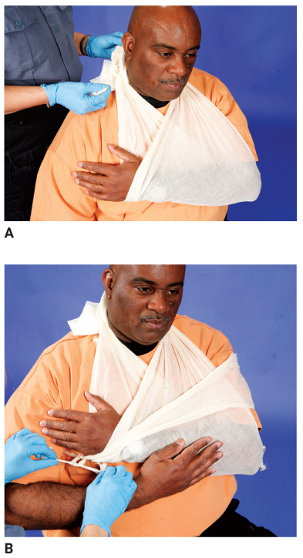
Injuries of the Clavicle and Scapula (3 of 3)
Acromioclavicular joint is frequently separated during sports.
These fractures can be splinted effectively with a sling and swathe.
FIGURE 32-31 A. Apply a sling so that the knot is tied to one side of the neck. B. Bind the arm to the chest wall with a swathe so that the arm cannot swing freely. Leave the patient’s fingers exposed so that you can assess distal circulation.
A, B: © Jones & Bartlett Learning. Courtesy of MIEMSS.
Notes:
Lecture Outline
3. The joint between the outer end of the clavicle and the acromion process of the scapula is called the acromioclavicular (AC) joint.
a. This joint is frequently separated during sports, such as football or hockey, when a player falls and lands on the point of the shoulder, driving the scapula away from the outer end of the clavicle.
4. These fractures can all be splinted effectively with a sling and swathe.

Slide 71
Dislocation of the Shoulder
The humeral head most commonly dislocates anteriorly.
Shoulder dislocations are very painful.
  Stabilization is difficult because any attempt to bring the arm in toward the chest wall produces pain.
  Splint the joint in whatever position is more comfortable for the patient.
Notes:
Lecture Outline
B. Dislocation of the shoulder
1. The glenohumeral joint (shoulder joint) is where the head of the humerus meets the glenoid fossa of the scapula.
2. The humeral head most commonly dislocates anteriorly, coming to lie in front of the scapula as a result of forced abduction and external rotation of the arm.
3. Shoulder dislocations are extremely painful.
a. Some patients may report numbness in the hand because of either nervous or circulatory compromise.
4. Stabilizing an anterior shoulder dislocation is difficult because any attempt to bring the arm in toward the chest wall produces pain.
a. You must splint the joint in whatever position is most comfortable for the patient.
b. Apply a sling to the forearm and wrist to support the weight of the arm.
c. Secure the arm in the sling to the pillow and chest with a swathe.
d. Transport the patient in a seated or semiseated position.

Slide 72
Fracture of the Humerus
Occur either proximally, in the midshaft, or distally at the elbow
Consider applying traction to realign the fracture fragments before splinting them.
Splint the arm with a sling and swathe.
Notes:
Lecture Outline
C. Fracture of the humerus
1. Occur either proximally, in the midshaft, or distally at the elbow.
2. With any severely angulated fracture, you should consider applying traction to realign the fracture fragments before splinting them.
a. Support the site of the fracture with one hand, and, with the other hand, grasp the two humeral condyles just above the elbow.
b. Pull gently in line with the normal axis of the limb.
c. Splint the arm with a sling and swathe, supplemented by a padded board splint on the lateral aspect of the arm.

Slide 73
Elbow Injuries (1 of 5)
Different types of injuries are difficult to distinguish without x-ray examinations.
Fracture of the distal humerus
  Common in children
  Fracture fragments rotate significantly, producing deformity and causing injuries to nearby vessels and nerves.
Notes:
Lecture Outline
D. Elbow injuries
1. Fractures and dislocations often occur around the elbow, and the different types of injuries are difficult to distinguish without radiographic examinations.
a. They all produce similar limb deformities and require the same emergency care.
2. Fracture of the distal humerus
a. This type of fracture, also known as a supracondylar or intercondylar fracture, is common in children.
b. Frequently, the fracture fragments rotate significantly, producing deformity and causing injuries to nearby vessels and nerves.
c. Swelling occurs rapidly and is often severe.

Slide 74
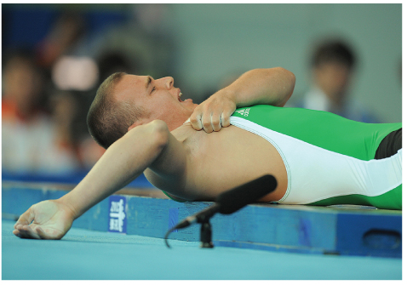
Elbow Injuries (2 of 5)
Dislocation of the elbow
  Typically occurs in athletes
  The ulna and radius are most often displaced posteriorly.
FIGURE 32-37 Posterior dislocation of the elbow makes the olecranon process of the ulna much more prominent.
© JUNG YEON-JE/AFP/Getty Images.
Notes:
Lecture Outline
3. Dislocation of the elbow
a. This type of injury typically occurs in athletes and rarely in young children.
b. The ulna and radius are most often displaced posteriorly relative to the humerus.
c. The posterior displacement makes the olecranon process of the ulna much more prominent.
d. There is swelling and significant potential for vessel or nerve injury.

Slide 75
Elbow Injuries (3 of 5)
Fracture of olecranon process of ulna
  Can result from direct or indirect forces
  Often associated with lacerations and abrasions
  Patient will be unable to extend the elbow.
Notes:
Lecture Outline
4. Fracture of the olecranon process of the ulna
a. Can result from direct or indirect forces and is often associated with lacerations and abrasions.
b. The patient will be unable to actively extend the elbow.

Slide 76
Elbow Injuries (4 of 5)
Fractures of the radial head
  Often missed during diagnosis
  Generally occurs as a result of a fall on an outstretched arm or a direct blow to the lateral aspect of the elbow
  Attempts to rotate the elbow or wrist cause discomfort.
Notes:
Lecture Outline
5. Fractures of the radial head
a. Often missed during diagnosis
b. Generally occurs as a result of a fall on an outstretched arm or a direct blow to the lateral aspect of the elbow.
c. Attempts to rotate the elbow or wrist cause discomfort.

Slide 77
Elbow Injuries (5 of 5)
Care of elbow injuries
  All elbow injuries are potentially serious and require careful management.
  Always assess distal neurovascular functions periodically.
  Provide prompt transport for all patients with impaired distal circulation.
Notes:
Lecture Outline
6. Care of elbow injuries
a. All elbow injuries are potentially serious and require careful management.
b. Always assess distal neurovascular functions periodically in patients with elbow injuries.
c. If you find strong pulses and good capillary refill, splint the elbow injury in the position in which you found it, adding a wrist sling if this seems helpful.
d. A cold, pale hand or a weak or absent pulse and poor capillary refill indicate that the blood vessels have likely been injured.
e. If the limb is pulseless and significantly deformed at the elbow, apply gentle manual traction in line with the long axis of the limb to decrease the deformity.
f. Provide prompt transport for all patients with impaired distal circulation.

Slide 78
Fractures of the Forearm
Common in people of all age groups
Seen most often in children and elderly
Usually the radius and the ulna break at the same time.
To stabilize fractures, you can use a padded board, air, vacuum, or pillow splint.
Notes:
Lecture Outline
E. Fractures of the forearm
1. Seen most often in children and older people.
2. Usually, both bones break at the same time when the injury is the result of a fall on an outstretched hand.
3. An isolated fracture of the shaft of the ulna may occur as the result of a direct blow to it (nightstick fracture).
4. Fractures of the distal radius, which are especially common in elderly patients with osteoporosis, are known as Colles fractures.
5. To stabilize fractures of the forearm or wrist, you can use a padded board, air, vacuum, or pillow splint.

Slide 79
Injuries of the Wrist and Hand
Must be confirmed by x-ray exams
Dislocations are usually associated with a fracture.
Isolated, nondisplaced fracture of a carpal bone is common.
Any questionable wrist injury should be splinted and evaluated in the ED.
Notes:
Lecture Outline
F. Injuries of the wrist and hand
1. Dislocations are usually associated with a fracture, resulting in a fracture-dislocation.
2. Another common wrist injury is the isolated, nondisplaced fracture of a carpal bone, especially the scaphoid.
3. Because the fingers and hands are required to function in such intricate ways, any injury that is not treated properly may result in permanent disability, as well as deformity.
4. Follow the steps in Skill Drill 32-4 to splint the hand and wrist.

Slide 80
Fractures of the Pelvis (1 of 3)
Often results from direct compression in the form of a heavy blow
May be accompanied by life-threatening loss of blood
Open fractures are quite uncommon.
Bone fragments can lacerate the rectum, vagina, and bladder.
Notes:
Lecture Outline
G. Fractures of the pelvis
1. Often results from direct compression in the form of a heavy blow that literally crushes the pelvis.
2. May be accompanied by life-threatening loss of blood from the laceration of blood vessels affixed to the pelvis at certain key points.
a. Up to several liters of blood may drain into the pelvic space and the retroperitoneal space, which lies between the abdominal cavity and the posterior abdominal wall.
b. Can result in significant hypotension, shock, and death.
3. Pelvis fracture fragments can lacerate the rectum, vagina, and bladder.

Slide 81
Fractures of the Pelvis (2 of 3)
Suspect a fracture of the pelvis in any patient who has sustained a high-velocity injury and complains of discomfort in the lower back or abdomen.
Assess for tenderness.
Injury to the bladder or the urethra may cause lower abdominal tenderness and evidence of hematuria or blood.
Notes:
Lecture Outline
Suspect a fracture of the pelvis in any patient who has sustained a high-velocity injury and complains of discomfort in the lower back or abdomen.
a. Deformity or swelling may be very difficult to see.
b. The most reliable sign of fracture of the pelvis is simple tenderness or instability on firm compression and palpation.
c. Assess for tenderness
5. Patients in stable condition can be secured to a long backboard or a scoop stretcher to stabilize isolated fractures of the pelvis.

Slide 82
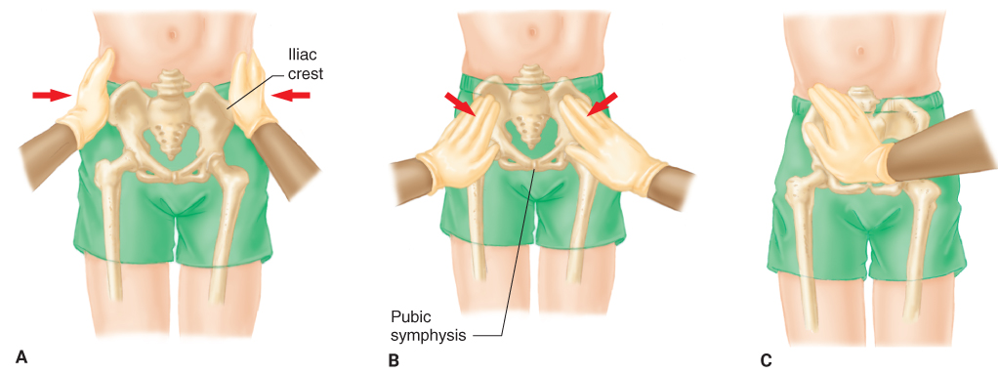
Fractures of the Pelvis (3 of 3)
FIGURE 32-42 A. To assess for tenderness or instability in the pelvic region, place your hands over the lateral aspect of each iliac crest, and gently compress the pelvis. B. With the patient in a supine position, place your palms over the anterior aspect of each iliac crest, and apply firm but gentle downward pressure. C. Palpate the pubic symphysis with the palm of your hand.
A, B, C: © Jones & Bartlett Learning.
Notes:
The figures on this slide show how to assess the pelvic region for tenderness or instability.

Slide 83
Dislocation of the Hip (1 of 3)
Dislocates only after significant injury
Most dislocations are posterior.
Suspect a dislocation in any patient who has been in an automobile crash and has a contusion, laceration, or obvious fracture in the knee region.
Notes:
Lecture Outline
H. Dislocation of the hip
1. The hip is a very stable ball-and-socket joint that dislocates only after significant injury.
2. Most dislocations of the hip are posterior, most commonly occurring as a result of a motor vehicle crash in which the knee meets with a direct force and the entire femur is driven posteriorly.

Slide 84
Dislocation of the Hip (2 of 3)
Posterior dislocation is frequently complicated by injury to the sciatic nerve.
Distinctive signs
  Severe pain in the hip
  Strong resistance to movement of the joint
  Tenderness on palpation
Notes:
Lecture Outline
3. Dislocation of the hip is associated with very distinctive signs.
a. Severe pain, resistance to movement, tenderness on palpation, and the ability to palpate the femoral head deep within the muscles of the buttock.

Slide 85
Dislocation of the Hip (3 of 3)
Do not attempt to reduce the dislocated hip in the field.
  Splint the dislocation.
  Place the patient supine on a backboard.
  Support the affected limb with pillows.
  Secure the entire limb to the backboard with long straps.
  Provide prompt transport.
Notes:
Lecture Outline
4. As with any other extremity injury, do not attempt to reduce the dislocated hip in the field unless medical control directs you to do so.
a. Splint the dislocation in the position of the deformity and place the patient supine on a long backboard.
b. Support the affected limb with pillows and rolled blankets and secure the limb to the backboard.

Slide 86
Fractures of the Proximal Femur (1 of 2)
Common fractures, especially in older people and patients with osteoporosis
Break goes through the neck of the femur, the interochanteric region, or across the proximal shaft of the femur.
Patients display characteristic deformity.
  Lie with the leg externally rotated, and injured limb is usually shorter than the opposite, uninjured limb.
Notes:
Lecture Outline
I. Fractures of the proximal femur
1. Fractures of the proximal end of the femur are common fractures, especially in older people and patients with osteoporosis.
2. The break goes through the neck of the femur, the intertrochanteric region, or across the proximal shaft of the femur.
3. Patients display a very characteristic deformity.
a. They lie with the leg externally rotated, and the injured limb is usually shorter than the opposite, uninjured limb.
b. Patients typically are unable to walk or move the leg.
c. The hip region is usually tender on palpation, and gentle rolling of the leg will cause pain but will not do further damage.

Slide 87
Fractures of the Proximal Femur (2 of 2)
Assess the pelvis for any soft-tissue injury and bandage appropriately.
Assess pulses and motor and sensory functions.
Splint the lower extremity and transport to the emergency department.
Notes:
Lecture Outline
4. Assess the pelvis for any soft-tissue injury and bandage appropriately.
5. Splint the lower extremity and transport to the emergency department.
6. Patients may have a significant blood loss.
a. Treat with high-flow oxygen, monitor vital signs, and be alert for signs of shock.

Slide 88
Femoral Shaft Fractures (1 of 2)
Can occur in any part of the shaft, from the hip region to the femoral condyles just above the knee joint
Large muscles of the thigh spasm in an attempt to “splint” the unstable limb.
  Produces significant deformity and shortened limb
There is often significant blood loss.
Notes:
Lecture Outline
J. Femoral shaft fractures
1. Can occur in any part of the shaft, from the hip region to the femoral condyles just above the knee joint.
2. Following a fracture, the large muscles of the thigh spasm in an attempt to “splint” the unstable limb.
a. The muscle spasm often produces significant deformity of the limb.
3. Fractures may be open.
4. There is often a significant amount of blood loss and it is not unusual for hypovolemic shock to develop.

Slide 89
Femoral Shaft Fractures (2 of 2)
Bone fragments may penetrate or press on important nerves and vessels.
  Carefully and periodically assess the distal neurovascular function.
Cover any wound with a dry, sterile dressing.
These fractures are best stabilized with a traction splint.
Notes:
Lecture Outline
Because of the severe deformity that occurs with these fractures, bone fragments may penetrate or press on important nerves and vessels and produce significant damage.
a. Carefully and periodically assess the distal neurovascular function in these patients.
6. Cover any wound with a dry, sterile dressing.
7. A fracture of the femoral shaft is best stabilized with a traction splint, such as a Sager splint.

Slide 90
Traction Splints (1 of 2)
Used primarily to secure fractures of the femur
Goals of in-line traction:
  To stabilize the fracture fragments
  To align the limb sufficiently
  To avoid potential neurovascular compromise
Notes:
Lecture Outline
K. Traction splints
1. Used primarily to secure fractures of the shaft of the femur, which are characterized by pain, swelling, and deformity of the midthigh.
2. Excessive traction can be harmful to an injured limb.
3. Goals of in-line traction:
a. Stabilize the fracture fragments to prevent excessive movement
b. Align the limb sufficiently to allow it to be placed in a splint
c. Avoid potential neurovascular compromise

Slide 91
Traction Splints (2 of 2)
Do not use for any of these conditions:
  Injuries of the upper extremity
  Injuries close to or involving the knee
  Injuries of the pelvis
  Partial amputations or avulsions with bone separation
  Lower leg, foot, or ankle injury
Notes:
Lecture Outline
4. Do not use traction splints for any of the follow conditions:
a. Injuries of the upper extremity
b. Injuries close to or involving the knee
c. Injuries of the pelvis
d. Partial amputations or avulsions with bone separation
e. Lower leg, foot, or ankle injury
5. To apply a Hare traction splint, follow the steps in Skill Drill 32-5.
6. Follow the steps in Skill Drill 32-6 to apply a Sager traction splint.

Slide 92
Injuries of Knee Ligaments (1 of 2)
Many different types of injuries occur in this region.
  Ligament injuries
  Dislocated patella
  Bony elements can fracture.
Notes:
Lecture Outline
L. Injuries of knee ligaments
1. The knee is very vulnerable to injury.
a. Ligament injuries range from mild sprains to complete dislocation of the joint.
b. The patella can also dislocate.
c. All the bony elements of the knee can fracture.

Slide 93
Injuries of Knee Ligaments (2 of 2)
With ligament injuries you will generally find:
  Swelling
  Occasional ecchymosis
  Point tenderness at the injury site
  A joint effusion
Splint all suspected knee ligament injuries.
Notes:
Lecture Outline
2. The knee is especially susceptible to ligament injuries, which occur when abnormal bending or twisting forces are applied to the joint.
a. The patient will report pain in the joint and be unable to use the extremity normally.
b. Swelling, bruising, tenderness and fluid in the joint are generally present.
3. You should splint all suspected knee ligament injuries.
a. The splint should extend from the hip joint to the foot, stabilizing the bone above the injured joint and the bone below it.
b. A variety of splints can be used, including a padded, rigid, long leg splint or two padded board splints.

Slide 94
Dislocation of the Knee (1 of 2)
These are true emergencies that may threaten the limb.
Ligaments may be damaged or torn.
Direction of dislocation refers to the position of the tibia with respect to the femur.
  Posterior dislocations
  Medial dislocations
Notes:
Lecture Outline
M. Dislocation of the knee
1. True emergencies that may threaten the limb.
2. When the knee is dislocated, the ligaments that provide support to it may be damaged or torn.
a. Always check the distal circulation carefully before taking any other step.
3. The direction of dislocation refers to the position of the tibia with respect to the femur.
a. Posterior knee dislocations are the most common, occurring in almost half of all cases.
b. Medial dislocations result from a direct blow to the lateral part of the leg.

Slide 95
Dislocation of the Knee (2 of 2)
Complications may include:
  Limb-threatening popliteal artery disruption
  Injuries to the nerves
  Joint instability
If adequate distal pulses are present, splint the knee and transport promptly.
Notes:
Lecture Outline
4. Patients will typically complain of pain in the knee and report that the knee “gave out.”
a. Complications include limb-threatening popliteal artery disruption, injuries to the nerves, and joint instability.
5. If adequate distal pulses are present, splint the knee in the position in which you found it, and transport the patient promptly.
6. Medical control may instruct you to attempt to realign a deformed, pulseless limb to reduce compression of the popliteal artery and restore distal circulation.

Slide 96
Fractures About the Knee (1 of 2)
May occur at the distal end of the femur, at the proximal end of the tibia, or in the patella
If there is an adequate distal pulse and no significant deformity, splint the limb with the knee straight.
Notes:
Lecture Outline
N. Fractures about the knee
1. May occur at the distal end of the femur, at the proximal end of the tibia, or in the patella.
2. Management of the two types of injuries is as follows:
a. If there is an adequate distal pulse and no significant deformity, splint the limb with the knee straight.

Slide 97
Fractures About the Knee (2 of 2)
If there is an adequate pulse and significant deformity, splint the joint in the position of deformity.
If the pulse is absent below the level of injury, contact medical control.
Never use a traction splint.
Notes:
Lecture Outline
b. If there is an adequate pulse and significant deformity, splint the joint in the position of deformity.
c. If the pulse is absent below the level of the injury, suspect possible vascular and nerve damage, and contact medical control.
d. Never use a traction splint if you suspect a fractured knee.

Slide 98
Dislocation of the Patella
Most commonly occurs in teenagers and young adults in athletic activities
Usually, the dislocated patella displaces to the lateral side and produces significant deformity.
Splint the knee in the position in which you find it.
Notes:
Lecture Outline
O. Dislocation of the patella
1. Usually, the dislocated patella displaces to the lateral side.
2. The displacement produces a significant deformity in which the knee is held in a moderately flexed position, and the patella is displaced to the lateral side of the knee.
3. Splint the knee in the position in which you found it.
a. Most often, this is with the knee flexed to a moderate degree.
b. Apply padded board splints to the medial and lateral aspects of the joint, extending from the hip to the ankle.

Slide 99
Injuries of the Tibia and Fibula
Fracture may occur at any place between the knee joint and the ankle joint.
  Often, both bones fracture at the same time.
Stabilize with a padded, rigid long leg splint or an air splint.
  Correct severe deformity with gentle longitudinal traction.
Notes:
Lecture Outline
P. Injuries of the tibia and fibula
1. Fracture of the shaft of the tibia or the fibula may occur at any place between the knee joint and the ankle joint.
a. Often, both bones fracture at the same time.
b. Even a single fracture may result in a severe deformity, with significant angulation or rotation.
c. Open fractures of the tibia are relatively common.
2. These fractures should be stabilized with a padded, rigid long leg splint or an air splint that extends from the foot to the upper thigh.
a. Correct severe deformity before splinting by applying gentle longitudinal traction.

Slide 100
Ankle Injuries (1 of 2)
The ankle is a commonly injured joint.
  Range from a simple sprains to severe fracture-dislocations
Any ankle injury that produces pain, swelling, localized tenderness, or the inability to bear weight must be evaluated by a physician.
Notes:
Lecture Outline
Q. Ankle injuries
1. The ankle is a commonly injured joint.
2. Ankle injuries occur in people of all ages and range in severity from a simple sprain to severe fracture-dislocations.
3. Any ankle injury that produces pain, swelling, localized tenderness, or the inability to bear weight must be evaluated by a physician.
4. The most frequent mechanism of ankle injury is twisting, which stretches or tears the supporting ligaments.

Slide 101
Ankle Injuries (2 of 2)
Management
  Dress all open wounds.
  Assess distal neurovascular function.
  Correct any gross deformity by applying traction.
  Before releasing traction, apply a splint.
Notes:
Lecture Outline
5. Manage injuries to the ankle as follows:
a. Dress all open wounds.
b. Assess distal neurovascular function.
c. Correct any gross deformity by applying gentle longitudinal traction to the heel.
d. Before releasing traction, apply a splint.

Slide 102
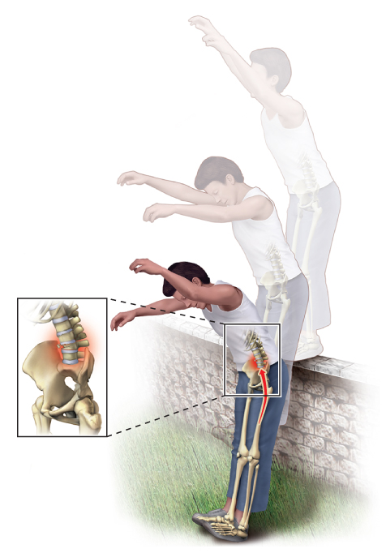
Foot Injuries (1 of 2)
Can result in the dislocation or fracture of one or more of the tarsals, metatarsals, or phalanges of the toes
Frequently, the force of injury is transmitted up the legs to the spine.
FIGURE 32-51 After a fall, the force of injury is transmitted up the legs to the spine, sometimes resulting in a fracture of the lumbar spine.
© Jones & Bartlett Learning.
Notes:
Lecture Outline
R. Foot injuries
1. Can result in the dislocation or fracture of one or more of the tarsals, metatarsals, or phalanges of the toes.
2. Frequently, the force of injury is transmitted up the legs to the spine, producing a fracture of the lumbar spine.

Slide 103
Foot Injuries (2 of 2)
If you suspect a foot dislocation, assess for pulses and motor and sensory functions.
Associated with significant swelling but rarely with gross deformity
To splint the foot, apply a rigid padded board splint, an air splint, or a pillow splint.
  Leave the toes exposed.
Notes:
Lecture Outline
3. If you suspect that the foot is dislocated, immediately assess for pulses and motor and sensory functions.
a. If pulses are present, immobilize the extremity using a splint, leaving the toes exposed to assess neurovascular function.
b. If pulses are absent, contact medical control.
4. Injuries of the foot are associated with significant swelling but rarely with gross deformity.
5. To splint the foot, apply a rigid padded board splint, an air splint, or a pillow splint, stabilizing the ankle joint and the foot.
a. Leave the toes exposed.
b. When the patient is lying on the stretcher, elevate the foot approximately 6 inches to minimize swelling.

Slide 104
Strains and Sprains
General treatment is similar to that of fractures
RICES
  Rest
  Ice
  Compression
  Elevation
  Splinting
Notes:
Lecture Outline
R. Strains and sprains
1. Treat every severe sprain as if it is a fracture.
2. General treatment is similar to that of fractures and includes RICES:
a. Rest
b. Ice
c. Compression
d. Elevation
e. Splinting

Slide 105
Amputations (1 of 2)
Surgeons can occasionally reattach amputated parts.
Make sure to immobilize the part with bulky compression dressings.
  Do not sever any partial amputations.
  Control any bleeding from the stump.
  If bleeding is severe, quickly apply a tourniquet.
Notes:
Lecture Outline
T. Amputations
1. Control bleeding and treat for shock.
2. Surgeons today can occasionally reattach amputated parts.
3. With partial amputations, make sure to immobilize the part with bulky compression dressings and a splint to prevent further injury.
a. Do not sever any partial amputations.
b. Control any bleeding from the stump.
c. If bleeding is severe, quickly apply a tourniquet.

Slide 106
Amputations (2 of 2)
With a complete amputation, wrap the clean part in a sterile dressing, and place it in a plastic bag.
  Follow local protocols regarding how to preserve amputated parts.
  Put the bag in a cool container filled with ice.
  The goal is to keep the part cool without allowing it to freeze or develop frostbite.
Notes:
Lecture Outline
4. With a complete amputation, make sure to wrap the clean part in a sterile dressing and place it in a plastic bag.
a. Follow local protocols regarding how to preserve amputated parts.
b. The goal is to keep the part cool without allowing it to freeze or develop frostbite.
c. The amputated part should be transported with the patient to the appropriate resource hospital.

Slide 107
Compartment Syndrome (1 of 3)
Most often occurs with a fractured tibia or forearm of children
Typically develops within 6 to 12 hours after injury, as a result of:
  Excessive bleeding
  A severely crushed extremity
  The rapid return of blood to an ischemic limb
Notes:
Lecture Outline
V. Compartment Syndrome
A. Compartment syndrome is a limb-threatening condition characterized by localized tissue swelling within a compartment.
1. Blood flow decreases inside a muscle compartment, ischemia results and anaerobic metabolism results. Tissue becomes damaged and can die.
2. Definitive treatment is a surgical procedure called a fasciotomy.
a. An incision through the skin and fascia allows the swollen muscle to expand, reducing pressure inside the compartment.
3. Compartment syndrome typically develops within 6 to 12 hours after injury, usual as a result of:
a. Excessive bleeding
b. A severely crushed extremity
c. The rapid return of blood to an ischemic limb

Slide 108
Compartment Syndrome (2 of 3)
Characterized by:
  Pain that is out of proportion to the injury
  Pain on passive stretching of muscles within the compartment
  Pallor
  Decreased sensation
  Decreased power
Notes:
Lecture Outline
4. Signs and symptoms include pain that is out of proportion to the injury, pain on passive stretch of the muscles within the compartment and altered sensation.
a. Additional signs may include pallor and decreased power.

Slide 109
Compartment Syndrome (3 of 3)
If you suspect the patient has compartment syndrome:
  Splint the affected limb, keeping it at the level of the heart
  Transport immediately.
  Reassess neurovascular status frequently during transport.
Notes:
Lecture Outline
5. If you suspect that a patient has compartment syndrome, splint the affected limb, keeping it at the level of the heart, and provide immediate transport.
a. Reassess neurovascular status frequently during transport.

Slide 110
Review
Skeletal muscle is also referred to as:
  smooth muscle.
  striated muscle.
  autonomic muscle.
  involuntary muscle.

Slide 111
Review
Answer: B
Rationale: Skeletal muscle, also called striated muscle because of its characteristic stripes (striations), attaches to the bones and usually crosses at least one joint, forming the major muscle mass of the body. This type of muscle is also called voluntary muscle because it is under direct voluntary control of the brain.

Slide 112
Review
Skeletal muscle is also referred to as:
  smooth muscle.
  Rationale: This is found in the walls of most tubular structures, internal organs, and the cardiovascular system.
  striated muscle.
  Rationale: Correct answer
  autonomic muscle.
  Rationale: This is not a term associated with the muscles.
  involuntary muscle.
  Rationale: Involuntary muscle is also called smooth muscle. It is not under voluntary control of the brain.

Slide 113
Review
You respond to a soccer game for a 16-year-old male with severe ankle pain. When you deliver him to the hospital, the physician tells you that he suspects a sprain. This means that:
  there is a disruption of the joint and the bone ends are no longer in contact.
  the patient has an incomplete fracture that passes only partway through the bone.
  stretching or tearing of the ligaments with partial or temporary dislocation of the bone ends has occurred.
  the muscles of the ankle have been severely stretched, resulting in displacement of the bones from the joint.

Slide 114
Review
Answer: C
Rationale: A sprain is a joint injury in which there is both partial or temporary dislocation of the bone ends and partial stretching or tearing of the supporting ligaments. Sprains are typically marked by swelling, pain, and ecchymosis.

Slide 115
Review
You respond to a soccer game for a 16-year-old male with severe ankle pain. When you deliver him to the hospital, the physician tells you that he suspects a sprain. This means that:
  there is a disruption of the joint and the bone ends are no longer in contact.
  Rationale: With a sprain, there will be a partial or temporary dislocation of the bone ends.
  the patient has an incomplete fracture that passes only partway through the bone.
  Rationale: With a sprain, there is no fracture associated with the injury.
  stretching or tearing of the ligaments with partial or temporary dislocation of the bone ends has occurred.
  Rationale: Correct answer
  the muscles of the ankle have been severely stretched, resulting in displacement of the bones from the joint.
  Rationale: A sprain is not an injury to the muscles.

Slide 116
Review
A young male has a musculoskeletal injury and is unresponsive. You will NOT be able to assess:
  false motion.
  distal pulses.
  capillary refill.
  sensory and motor functions.

Slide 117
Review
Answer: D
Rationale: In order to assess sensory and motor functions (eg, Can you feel? Can you move?), the patient must be conscious, alert, and able to follow commands. False motion, distal pulses, and capillary refill are objective findings; therefore, they can be assessed in unresponsive patients.

Slide 118
Review
A young male has a musculoskeletal injury and is unresponsive. You will NOT be able to assess:
  false motion.
  Rationale: This is an objective finding.
  distal pulses.
  Rationale: This is an objective finding.
  capillary refill.
  Rationale: This is an objective finding.
  sensory and motor functions.
  Rationale: Correct answer

Slide 119
Review
The purpose of splinting a fracture is to:
  reduce the fracture if possible.
  prevent motion of bony fragments.
  reduce swelling in adjacent soft tissues.
  force the bony fragments back into anatomic alignment.

Slide 120
Review
Answer: B
Rationale: The purpose of splinting a fracture is to prevent motion of the bony fragments, thus minimizing the possibility of neurovascular damage. Splinting is not intended to force bony fragments into anatomic alignment, nor will it reduce swelling (ice reduces swelling). You should never try to reduce a fracture.

Slide 121
Review
The purpose of splinting a fracture is to:
  reduce the fracture if possible.
  Rationale: Reduction of a suspected fracture is a medical procedure to be performed in the hospital.
  prevent motion of bony fragments.
  Rationale: Correct answer
  reduce swelling in adjacent soft tissues.
  Rationale: Splinting will not reduce swelling, but cold application will.
  force the bony fragments back into anatomic alignment.
  Rationale: Splinting to immobilize a fracture site is not intended to force bony fragments back into alignment.

Slide 122
Review
A motorcyclist crashed his bike and has closed deformities to both of his midshaft femurs. He is conscious, but restless; his skin is cool and clammy; and his radial pulses are rapid and weak. The MOST appropriate splinting technique for this patient involves:
  applying rigid board splints.
  applying two traction splints.
  securing him to a long backboard.
  immobilizing his femurs with air splints.

Slide 123
Review
Answer: C
Rationale: In this particular case, it is more practical—and less time-consuming—to secure the patient to a long backboard. He is in shock and requires rapid transport. Taking the time to apply traction splints, air splints, or board splints will only delay transport.

Slide 124
Review
A motorcyclist crashed his bike and has closed deformities to both of his midshaft femurs. He is conscious, but restless; his skin is cool and clammy; and his radial pulses are rapid and weak. The MOST appropriate splinting technique for this patient involves:
  applying rigid board splints.
  Rationale: This causes undue delays in the transport of the patient.
  applying two traction splints.
  Rationale: This causes undue delays in the transport of the patient.
  securing him to a long backboard.
  Rationale: Correct answer
  immobilizing his femurs with air splints.
  Rationale: This causes undue delays in the transport of the patient.

Slide 125
Review
To effectively immobilize a fractured clavicle, you should apply a(n):
  sling and swathe.
  air splint over the entire arm.
  rigid splint to the upper arm, then a sling.
  traction splint to the arm of the injured side.

Slide 126
Review
Answer: A
Rationale: The quickest and most effective way to immobilize a fractured clavicle (collarbone) is to apply a sling and swathe. The sling will help minimize movement of the clavicle itself, while the swath will minimize movement of the arm on the affected side.

Slide 127
Review
To effectively immobilize a fractured clavicle, you should apply a(n):
  sling and swathe.
  Rationale: Correct answer
  air splint over the entire arm.
  Rationale: An air splint is not effective on a joint.
  rigid splint to the upper arm, then a sling.
  Rationale: A sling will not prevent the movement of the shoulder.
  traction splint to the arm of the injured side.
  Rationale: There is no traction splint for the arm.

Slide 128
Review
A patient tripped, fell, and landed on her elbow. She is in severe pain and has obvious deformity to her elbow. You should:
  assess distal pulses.
  manually stabilize her injury.
  assess her elbow for crepitus.
  apply rigid board splints to her arm.

Slide 129
Review
Answer: B
Rationale: When caring for a patient with an orthopaedic injury, you should first manually stabilize the injury site; this will prevent further injury. You should then assess pulse, motor functions, and sensory functions distal to the injury. Splint the injury using the appropriate technique, and then reassess pulse, motor functions, and sensory functions. Do not intentionally assess for crepitus; this is a coincidental finding that you may encounter during your assessment and should not be elicited.

Slide 130
Review
A patient tripped, fell, and landed on her elbow. She is in severe pain and has obvious deformity to her elbow. You should:
  assess distal pulses.
  Rationale: This is completed after the manual stabilization of the injury.
  manually stabilize her injury.
  Rationale: Correct answer
  assess her elbow for crepitus.
  Rationale: Do not intentionally assess for crepitus; this is a coincidental finding.
  apply rigid board splints to her arm.
  Rationale: This is completed after manual stabilization of the injury.

Slide 131
Review
When treating an open extremity fracture, you should:
  apply a splint and then dress the wound.
  dress the wound before applying a splint.
  irrigate the wound before applying a dressing.
  allow the material that secures the splint to serve as the dressing.

Slide 132
Review
Answer: B
Rationale: Prior to splinting an open extremity fracture, you should cover the wound with a dry, sterile dressing. This will help control any bleeding and decreases the risk of infection. Irrigating an open fracture should be avoided in the field; this also increases the risk of infection—especially if foreign material is flushed into the wound.

Slide 133
Review
When treating an open extremity fracture, you should:
  apply a splint and then dress the wound.
  Rationale: The dressing must come before the splint.
  dress the wound before applying a splint.
  Rationale: Correct answer
  irrigate the wound before applying a dressing.
  Rationale: Irrigation of an open fracture in the prehospital setting may increase the chance of infection.
  allow the material that secures the splint to serve as the dressing.
  Rationale: The wound must be dressed separately from the splint and before splinting is done.

Slide 134
Review
Which of the following musculoskeletal injuries has the GREATEST risk for shock due to blood loss?
  Pelvic fracture
  Posterior hip dislocation
  Unilateral femur fracture
  Proximal humerus fracture

Slide 135
Review
Answer: A
Rationale: The pelvic cavity can accommodate a large volume of blood. Shock in a patient with a pelvic injury is usually due to injury to femoral veins or arteries. Bilateral femur fractures can also cause severe blood loss (up to 1 liter per femur).

Slide 136
Review
Which of the following musculoskeletal injuries has the GREATEST risk for shock due to blood loss?
  Pelvic fracture
  Rationale: Correct answer
  Posterior hip dislocation
  Rationale: Unless the dislocation has injured the vascular system, bleeding will be contained and minimal.
  Unilateral femur fracture
  Rationale: A unilateral femur fracture can lose 500 to 1,500 mL of blood.
  Proximal humerus fracture
  Rationale: Nerves and blood vessels can be injured, and the blood loss could be 500 mL.

Slide 137
Review
A patient injured her knee while riding a bicycle. She is lying on the ground, has her left leg flexed, is in severe pain, and cannot move her leg. Your assessment reveals obvious deformity to her left knee. Distal pulses are present and strong. The MOST appropriate treatment for her injury involves:
  wrapping her entire knee area with a pillow.
  splinting the leg in the position in which it was found.
  straightening her leg and applying two rigid board splints.
  straightening her leg and applying and inflating an air splint.

Slide 138
Review
Answer: B
Rationale: The patient likely has a dislocated knee. You should immobilize any joint injury in the position in which it was found—especially if distal pulses are present and strong. Attempting to straighten a dislocated joint may cause damage to the nerves and/or vasculature.

Slide 139
Review
A patient injured her knee while riding a bicycle. She is lying on the ground, has her left leg flexed, is in severe pain, and cannot move her leg. Your assessment reveals obvious deformity to her left knee. Distal pulses are present and strong. The MOST appropriate treatment for her injury involves:
  wrapping her entire knee area with a pillow.
  Rationale: Providers can wrap the knee with a pillow to splint it. It is most important to splint the joint in the position it was found.
  splinting the leg in the position in which it was found.
  Rationale: Correct answer
  straightening her leg and applying two rigid board splints.
  Rationale: The straightening of a joint injury is contraindicated if the pulses are intact.
  straightening her leg and applying and inflating an air splint.
  Rationale: Air splints are not effective on joint injuries that are flexed.

